Slide 1


Constituency Connect
Group Members:
Muhammad Ahsan 21-Arid-737
Huzaifa Bin shahzad 21-Arid-719
Haseeb ur Rehman 21-Arid-715
Supervised By:
Ms. Farkhanda Qamar
UNIVERSITY INSTITUTE OF INFORMATION TECHNOLOGY

Slide 2
Table of Contents
Introduction
Literature Review
Benchmarking
Problem Statement
Proposed Model/Solution
Scope
Tools and Technologies (Market Based)
Final Outcome

Slide 3
Introduction
Prepare at-least two (2) slides to briefly describe your project idea.
Properly reference [1] previously used tools and technologies.
If your FYP is related to research oriented properly add references of the paper [2].

Slide 4
Introduction
Constituency Connect is a web-based platform designed to enhance the communication and engagement between constituents and their elected representatives. This application enables constituents to report complaints using multimedia formats such as text, audio, video, pictures, and voice notes. These complaints are forwarded to the respective departments and prioritized based on the issue's sensitivity. A complaint tracking dashboard allows users to monitor the status and resolution of their reported issues. Additional features include survey and polling systems, virtual meetups for video conferencing, interactive maps for complaint mapping, anonymous reporting, and feedback systems. Constituency Connect ensures better transparency and responsiveness in governance, making it easier for representatives to address citizens' concerns effectively.

Slide 5
Tools and Technologies
The Frontend of the project will utilize:
HTML5: For structuring the content.
CSS3: To style and layout the web pages with animations and responsive design.
Tailwind CSS and Bootstrap: For a utility-first approach and responsive grid systems to speed up UI development.
JavaScript and React JS: To handle logic and build the user interface of the application.
Redux Toolkit: To manage the state of the application in a centralized and efficient manner.
Material UI: For modern and consistent UI components.
React Hook Form: To handle and validate forms effortlessly.
React Router: For smooth navigation between different sections of the application.
React Query: To efficiently manage and synchronize API data.

Slide 6
Tools and Technologies
The Backend will incorporate:
Node JS and Express JS: To build the server-side functionality, providing a non-blocking architecture for scalability.
MongoDB and Mongoose: For handling unstructured data, offering flexibility and high performance at scale.

Slide 7
Literature Review
Prepare at-least five (5) slides and develop a base for your project starting from initial technology/research.
Properly reference previously used tools and technologies [3].

Slide 8
Literature Review Introduction to Constituency Connect
Objective:
Enhance communication between elected representatives and constituents through a digital platform.
Facilitate issue reporting, engagement, and transparency in governance.
Significance:
Address gaps in traditional complaint resolution systems.
Foster a sense of community and accountability among stakeholders.

Slide 9
Literature Review Initial Technologies
Frontend Technologies:
HTML5 & CSS3: For creating the structure and design of the platform, ensuring responsiveness and accessibility.
JavaScript & React JS: To build interactive user interfaces, enabling dynamic updates and efficient data handling.
Backend Technologies:
Node.js & Express.js: For server-side development, managing API requests, and handling user data efficiently.
MongoDB & Mongoose: For database management, enabling scalable and flexible data storage.
Tools & Libraries:
Redux Toolkit: For state management, facilitating smooth data flow within the application.
React Hook Form: To simplify form handling and validation, ensuring a user-friendly experience.

Slide 10
Literature Review Literature on Citizen Engagement Platforms
Research Context:
Studies indicate that technology enhances citizen engagement and feedback in governance.
Successful platforms emphasize user-centric design, ensuring accessibility and ease of use.
Key Features Identified:
Complaint reporting and tracking.
Surveys and polls for gathering public opinion.
Virtual interactions and community-building efforts.
Existing Gaps:
Limited platforms address multilingual support and anonymous reporting effectively.

Slide 11
Literature Review Features and Their Importance
Complaint Reporting:
Provides a direct channel for constituents to voice issues, ensuring transparency and accountability.
Real-time Statistics:
Enhances decision-making for representatives by providing insights into community needs and concerns.
Anonymous Reporting:
Encourages more users to participate without fear of repercussions, leading to higher engagement rates.
Virtual Meetups:
Fosters direct interaction between constituents and representatives, building trust and community involvement.

Slide 12
Literature Review Refrences
Initial Technologies:
React Documentation. (2024). [Link to React docs].
Node.js Documentation. (2024). [Link to Node.js docs].
MongoDB Documentation. (2024). [Link to MongoDB docs].
Additional Resources:
Articles on user engagement strategies in digital platforms.
Case studies of successful citizen engagement initiatives.

Slide 13
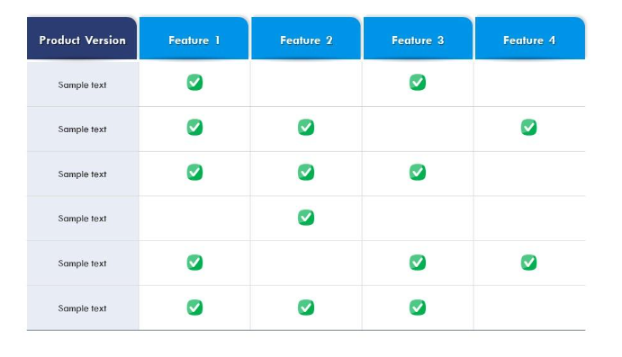
Benchmarking
Once you cover basic understanding of problem, now you will map them in the form of a table to narrow down your problem.

Slide 14
Benchmarking
Feature | Constituency Connect | Existing Solution A | Existing Solution B | Existing Solution C
Complaint Reporting | Yes | Yes | Yes | No
Complaint Forwarding | Yes | Yes | No | Yes
Complaint Prioritization | Yes | No | Yes | No
Surveys and Polls | Yes | Yes | Yes | Yes
Real-time Statistics | Yes | No | Yes | Yes
Complaint Tracking Dashboard | Yes | yes | Yes | No
Anonymous Reporting | Yes | No | No | Yes
Feedback Mechanism | Yes | Yes | Yes | No
Virtual Meetups | Yes | No | Yes | No
Event Calendar | Yes | Yes | No | Yes
Push Notifications | Yes | No | Yes | Yes
Multi-Language Support | Yes | No | Yes | Yes
Mobile Accessibility | Yes | Yes | No | Yes

Slide 15
Problem Statement
Define your problem in one paragraph keep in mind your literature review limitations and the gaps identified in the benchmarking table.

Slide 16
Problem Statement
Despite the increasing digitization of public services, many existing platforms for constituent engagement fail to effectively address the diverse needs of users when it comes to reporting issues and interacting with elected representatives. Current solutions often lack essential features such as comprehensive complaint tracking, real-time updates, and anonymous reporting, which discourage constituents from voicing their concerns. Furthermore, the absence of user-friendly interfaces and multi-language support limits accessibility for a broader audience. The "Constituency Connect" project aims to fill these gaps by providing a robust, transparent platform that enhances communication between constituents and their representatives, facilitates issue reporting, and promotes community engagement through features like virtual meetups and surveys. This initiative seeks to empower constituents by ensuring their voices are heard and acted upon while improving the overall efficiency of public service responsiveness.

Slide 17
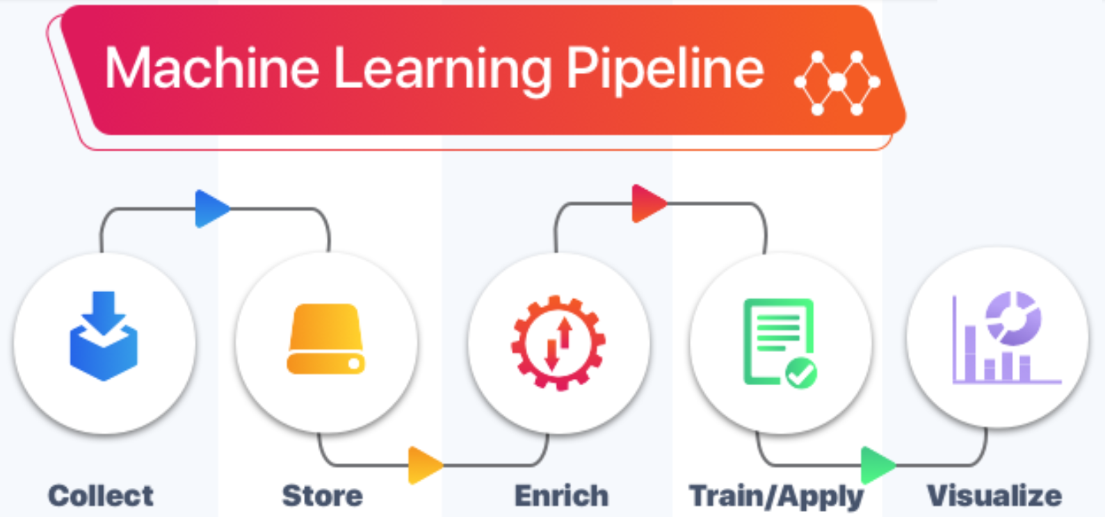
Proposed Model
Write down abstract idea of your project, and add its model diagram

Slide 18
Scope of your Project
Properly write the scope of your project. Avoid general solutions.

Slide 19
Scope of your Project
The Constituency Connect project focuses on enhancing the communication and interaction between constituents and their elected representatives through a specialized web-based application. The scope is defined by the following key elements:
1. Complaint Management System:
The platform allows users to submit complaints with multimedia support (text, images, videos) to ensure comprehensive documentation.
Complaints will be categorized by type and prioritized based on urgency, ensuring that critical issues receive prompt attention.
2. Real-Time Monitoring and Tracking:
Users can access a dedicated dashboard to track the status of their complaints, including updates and actions taken by the relevant departments.
The application will provide real-time statistics on complaint submissions, resolutions, and overall performance metrics.

Slide 20
Scope of your Project
1. Engagement Features:
The application will include features for creating surveys , polls and virtual meetups to gather public opinions on community issues, proposed initiatives, or events.
2. Feedback Mechanism:
A structured feedback system will allow constituents to evaluate the complaint resolution process and suggest improvements, fostering accountability.
3. Multi-Language Support:
To ensure accessibility for a diverse user base, the platform will support multiple languages, catering to different linguistic communities.
4. Event Management:
The project will include an event calendar where representatives can post upcoming community activities, ensuring constituents remain informed and engaged.

Slide 21
Scope of your Project
Limitations:
The project will initially focus on a specific geographic constituency, with future scalability planned to expand its reach.
While the platform will integrate with existing government databases, it will not replace existing governmental complaint management systems but rather enhance them.

Slide 22
Tools and Technologies (Market Base)
List down tools and technologies, you want to use for development purposes. Avoid old ones, explore market oriented tools and technologies.

Slide 23
Tools and Technologies (Market Base)
Frontend Development:
React.js: A popular JavaScript library for building user interfaces, particularly single-page applications, that allows for efficient component-based architecture and state management.
Tailwind CSS: A utility-first CSS framework that enables rapid UI development with a responsive design approach.
Redux Toolkit: A state management library that helps manage application state efficiently, making it easier to share data between components.
2. Backend Development:
Node.js: A JavaScript runtime built on Chrome's V8 engine, enabling the development of scalable and high-performance server-side applications.
Express.js: A minimal and flexible Node.js web application framework that provides a robust set of features for building APIs and web applications.

Slide 24
Tools and Technologies (Market Base)
3. Database Management:
MongoDB: A NoSQL database that stores data in flexible, JSON-like documents, allowing for easy scalability and efficient querying, which is ideal for handling various complaint records.
4. API Management:
GraphQL: A query language for APIs that provides a more efficient and flexible alternative to REST, allowing clients to request only the data they need.
Postman: A collaboration platform for API development that enables testing, monitoring, and documenting APIs.
5. Deployment and DevOps:
Docker: A platform for developing, shipping, and running applications in containers, ensuring consistency across environments.
Heroku: A cloud platform that enables developers to build, run, and operate applications entirely in the cloud, facilitating easy deployment and scaling.

Slide 25
Tools and Technologies (Market Base)
6. Real-time Communication:
Socket.IO: A library for real-time web applications that enables bi-directional communication between web clients and servers, ideal for implementing features like live updates for complaints.
7. Analytics and Monitoring:
Google Analytics: A web analytics service that tracks and reports website traffic, allowing for data-driven decisions to enhance user experience.
Sentry: An error tracking tool that helps monitor application performance and errors in real-time.
8. User Authentication:
Firebase Authentication: A comprehensive identity solution that provides authentication services, including email/password, social login, and anonymous login.

Slide 26
Final Outcome
Describe shortly the nature of your project outcome.
Whether it’s a Advance Technology/ Product / Framework/ Solution to the existing Problem or a novel research, etc.

Slide 27
Final Outcome
The final outcome of this project is a comprehensive web-based application called Constituency Connect, designed to enhance communication between elected representatives and their constituents. This solution leverages advanced technologies and frameworks to create an efficient platform for complaint reporting, tracking, and engagement.
Key Features:
Multimedia Complaint Reporting: Users can submit complaints through various media formats, ensuring comprehensive documentation of issues.
Real-time Tracking Dashboard: Constituents can monitor the status of their complaints, fostering transparency and accountability.
Virtual Meetups and Video Conferencing: Facilitates direct communication between constituents and representatives, promoting community involvement and feedback.
Surveys and Polls: Allows representatives to gather public opinions and improve decision-making processes based on community input.
Constituency Connect aims to set a new standard for civic engagement platforms.

Slide 28
References
www.deeplearning.ai (Last visit date 13-09-2024)
M. Habib, A. Hussain, S. Rasheed, M. Ali, Adaptive fuzzy inference system based directional median filter for impulse noise removal, AEU - International Journal of Electronics and Communications, 70 (5), 2016, 689-697, https://doi.org/10.1016/j.aeue.2016.02.005.
…

Slide 29


